Slide 1



Google Play Store Insights via Tableau
95%

Slide 2

Rationale: Explore Android App Market
Business Problem
Google Play Store is an online app store on Android. Over 2.5 billion monthly users are using an Android device and have a high demand on app downloading and usage. Until June 2024, Android is still the most popular mobile operating system, taking 70.93% global market share. Therefore the motivation to explore the largest Android App market inspired us to unveil the insights for Google Play Store.
How to solve
The key to investigate findings from the google play store is to find a dataset. Kaggle provides a perfect dataset for us, which includes all the key information of an app. By exploring the dataset and draw visualization from it will help us to better understand the Android App Market and further provide suggestions for the stakeholders like users, app developers or researchers.
95%

Slide 3
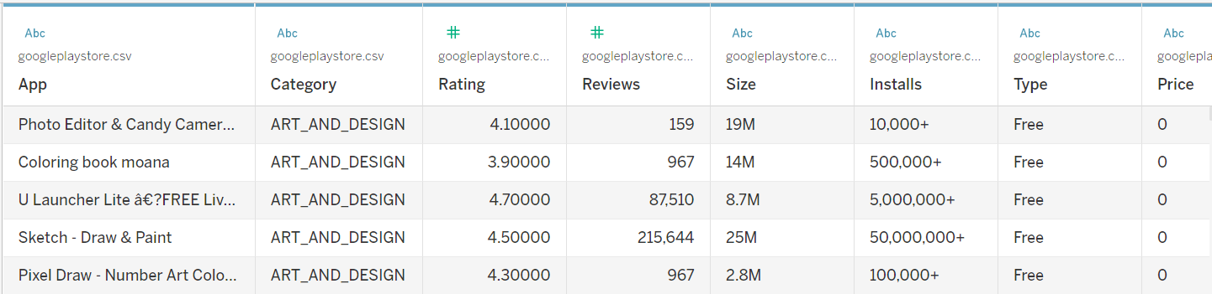
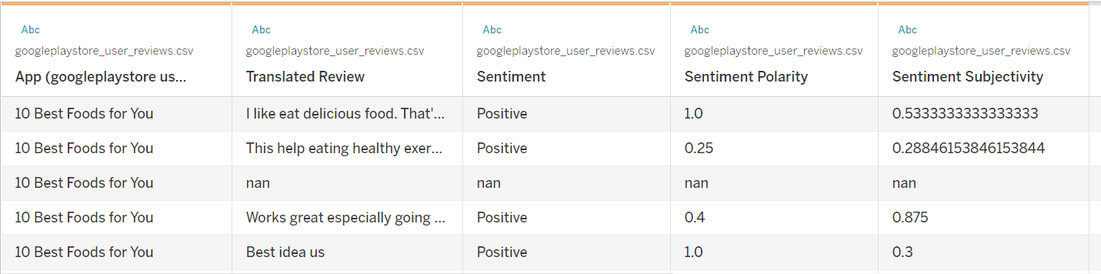
Dataset Description
95%
Kaggle Datasets: all the information and data are derived from the Google Play Store
Googleplaystore.csv: each row with 13 columns represents a particular app, including category, rating, size, price and more details
Googleplaystore_user_reviews.csv is a dataset record all the reviews for each app. Each row is a review for an app. 5 columns are review sentiment, sentiment polarity and more.

Slide 4
Research Question Contents
App Category
95%
App Sizing
Relationship between category and count of installed
How to decide the optimal size?
App Pricing
App Reviews
App Rating
How different do users
perceive free and paid apps?
Which category are
dominant by paid/free apps?
Which app can we choose to download?
What Decide Rating？

Slide 5

Glimpse of the dataset
95%
From a content rating perspective to give a glimpse of how the apps are distributed and show some basic feature information
Mobile App
Notes:
To start our visualization roadmap, we first generate a brief overview of the dataset to give everyone a glimpse of the information provided by the dataset.

Slide 6
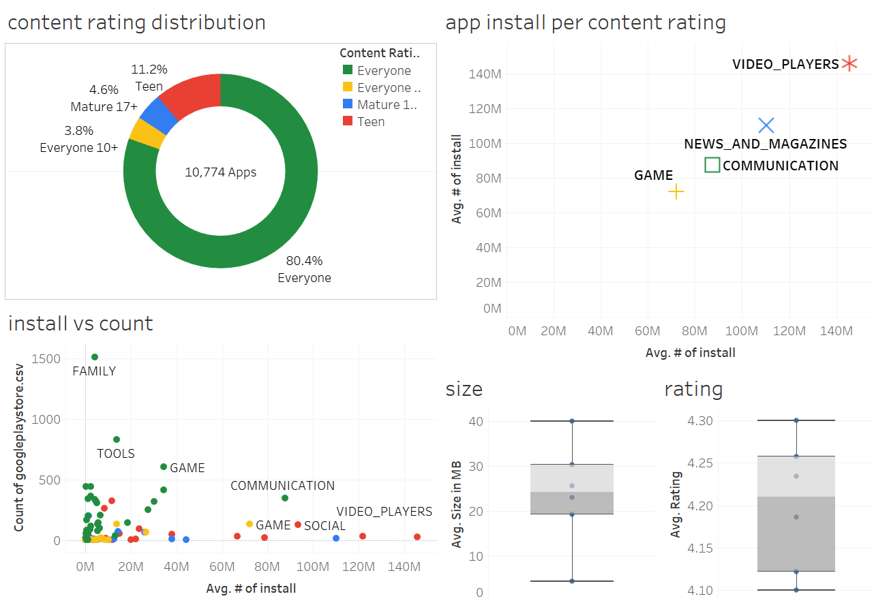
“Everyone” is the most popular rating, indicating that most of the apps in the market are made for everyone
The amount is not the key to win over the users.
Notes:
By exploring the content rating distribution, we found that everyone has the largest amount of app in the store, followed by the teen. As the result, most of the apps are made for everyone as the target group, which could reveal a competitive landscape.
And the right two boxplots shows average rating is in range 4.1 to 4.3 for content rating groups, and average size for them are in range 5mb up to 40 mb.
When we looked at the count of apps in each category and content rating versus number of installs, the scatter plot indicates that the amount is not the key to win over the users. And then, we explore that in each content rating, top installed categories are video_player for teen, news and magazines for mature 17+, communication for everyone, and then game for everyone 10+. In the following, my team members will present more detailed findings from various app perspectives.

Slide 7
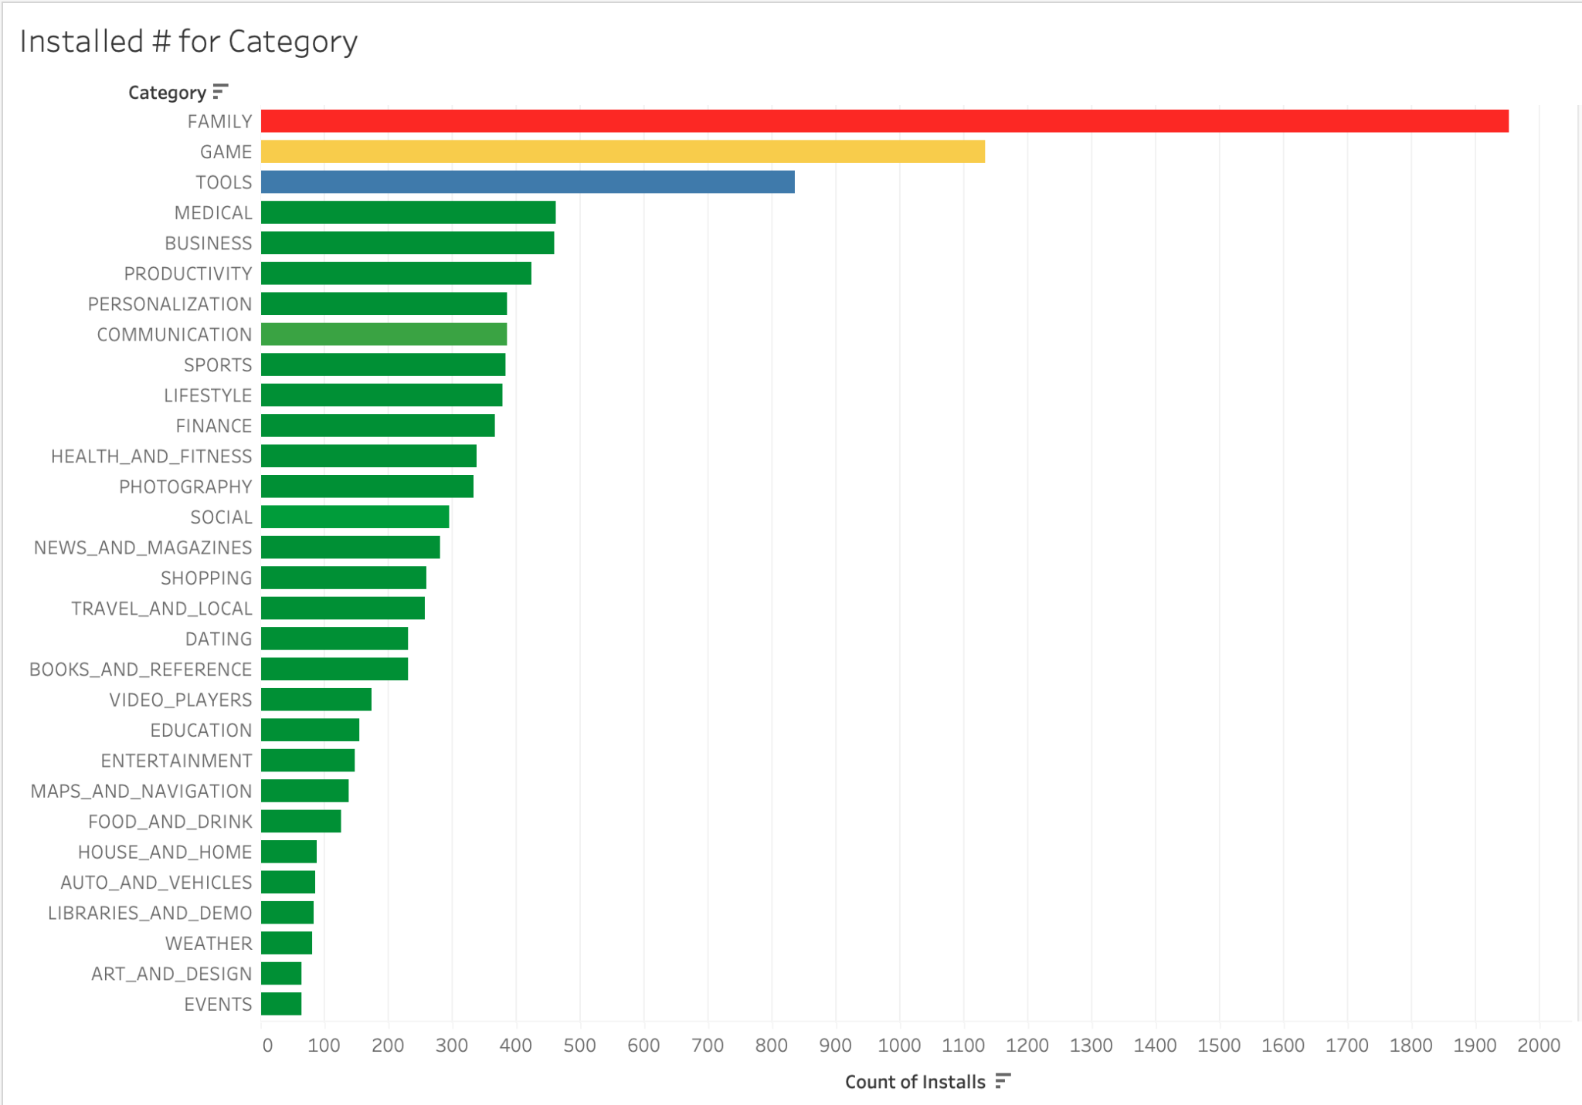
App Installed Count and Category
95%
Which app category has the highest number of installs and what factors contribute to its popularity?
Top Installed Category:
Family
Game
Tools
Notes:
The analysis of app categories shows that Family, Game, and Tools apps have the highest number of installs. Family apps lead in popularity, likely because they offer educational games, entertainment, and parental tools that appeal to a broad audience, including parents and children. Game apps also see high install numbers due to their wide range of entertainment options catering to all age groups, from casual gamers to competitive players. Tools apps are popular for their practical use, helping users with everyday tasks like file management and phone optimization. The factors contributing to the popularity of these categories include ease of use, functionality, entertainment value, and regular updates. Apps that are user-friendly and solve specific problems or provide significant entertainment tend to attract more users.

Slide 8
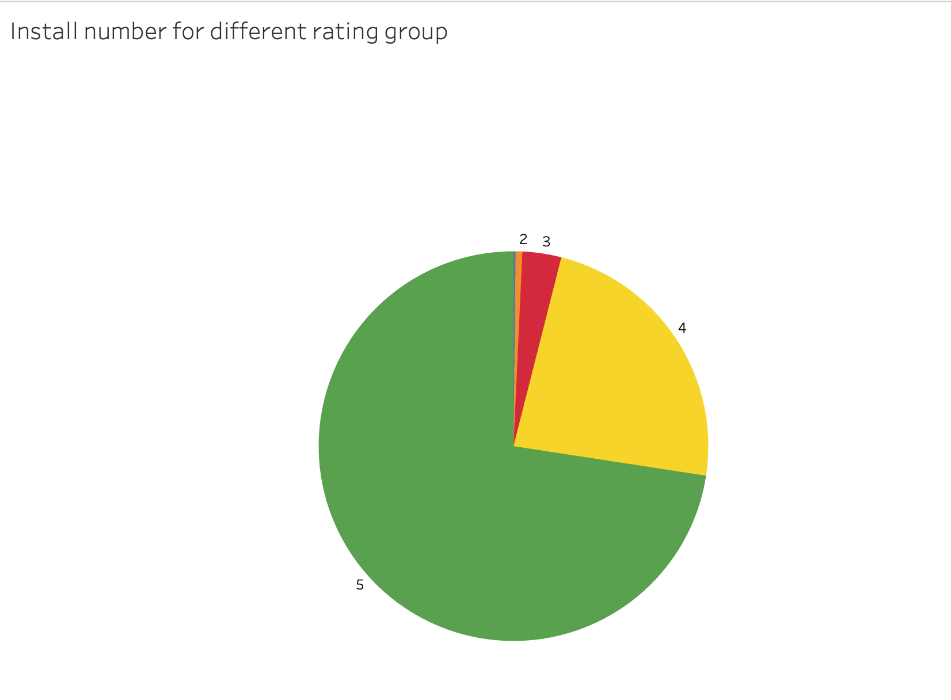
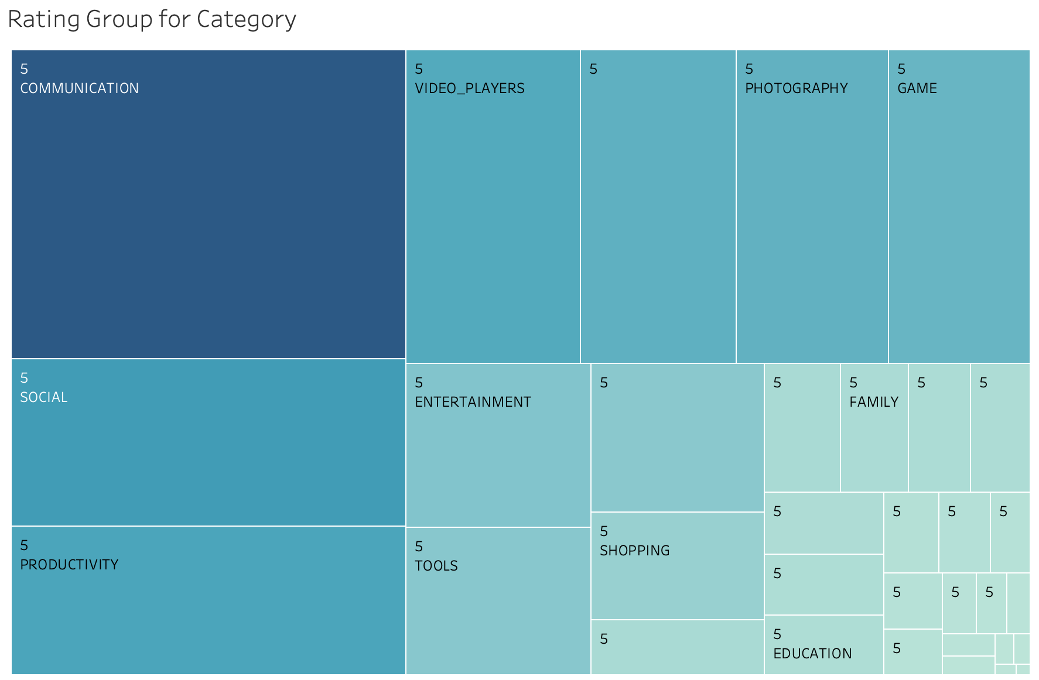
Category Installed Count and Rating
95%
What is the correlation between high average ratings (5 stars) and the number of installs for each category?
Notes:
Additionally, there is a clear correlation between high average ratings ( 5 stars) and the number of installs.When analyzing the correlation between high average ratings ( 5 stars) and the number of installs for each app category, it becomes clear that higher ratings significantly influence the number of installs. The pie chart demonstrates that apps with 5-star ratings dominate in terms of install numbers, indicating that users trust and prefer highly rated apps. The treemap further supports this by showing that categories such as Communication, Video Players, and Games, which have high average ratings, also have a large number of installs. This strong correlation suggests that users are more likely to download apps that others have rated highly, reflecting a trend where user reviews and ratings heavily influence app popularity.

Slide 9
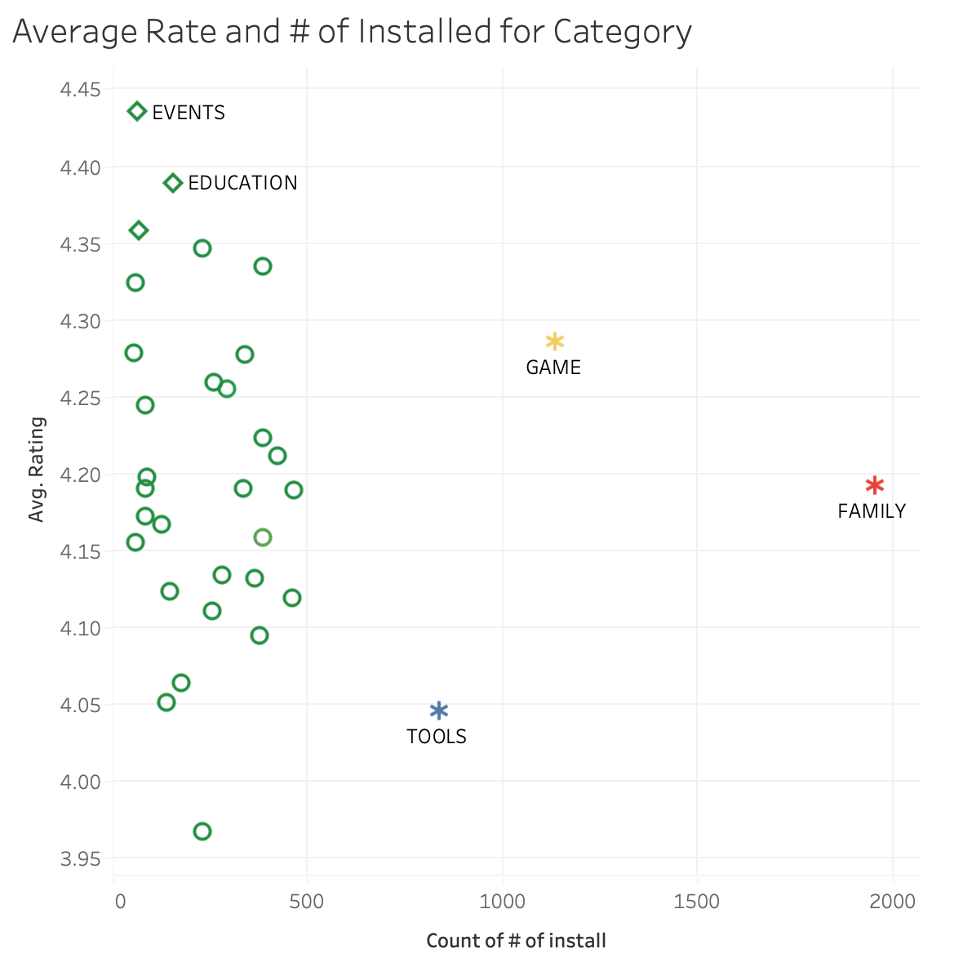
Outlier Category
95%
Are there any outlier categories with exceptionally high or low average ratings despite their install counts?
High ratings typically correlate with more installs.
Other factors such as app necessity, specific user needs, and utility also influence popularity.
Notes:
When analyzing the correlation between ratings and install counts, we find some outliers. Family apps have many installs despite an average rating around 4.2, suggesting their necessity drives downloads. Tools apps, with fewer installs but high ratings, are highly valued by a smaller user base. Events apps have high ratings but fewer installs, showing high user satisfaction despite lower usage. These outliers indicate that while high ratings generally lead to more installs, factors like app necessity and specific user needs also influence popularity. This ties back to the importance of utility, ease of use, and entertainment value in driving app success.

Slide 10
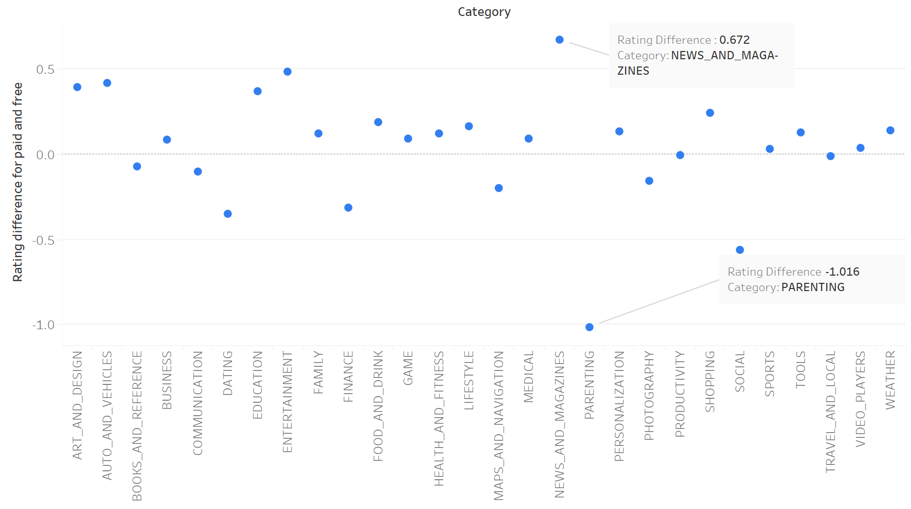
Are you interested in Pricing?
95%
Let’s delve into the intricacies of app pricing on the Google Play Store
most categories have higher ratings for paid apps

Slide 11
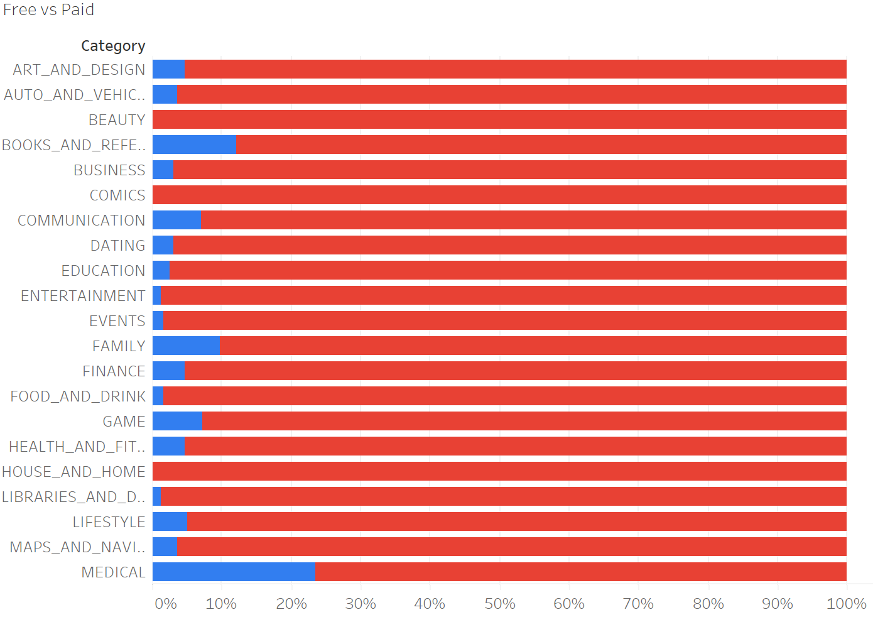
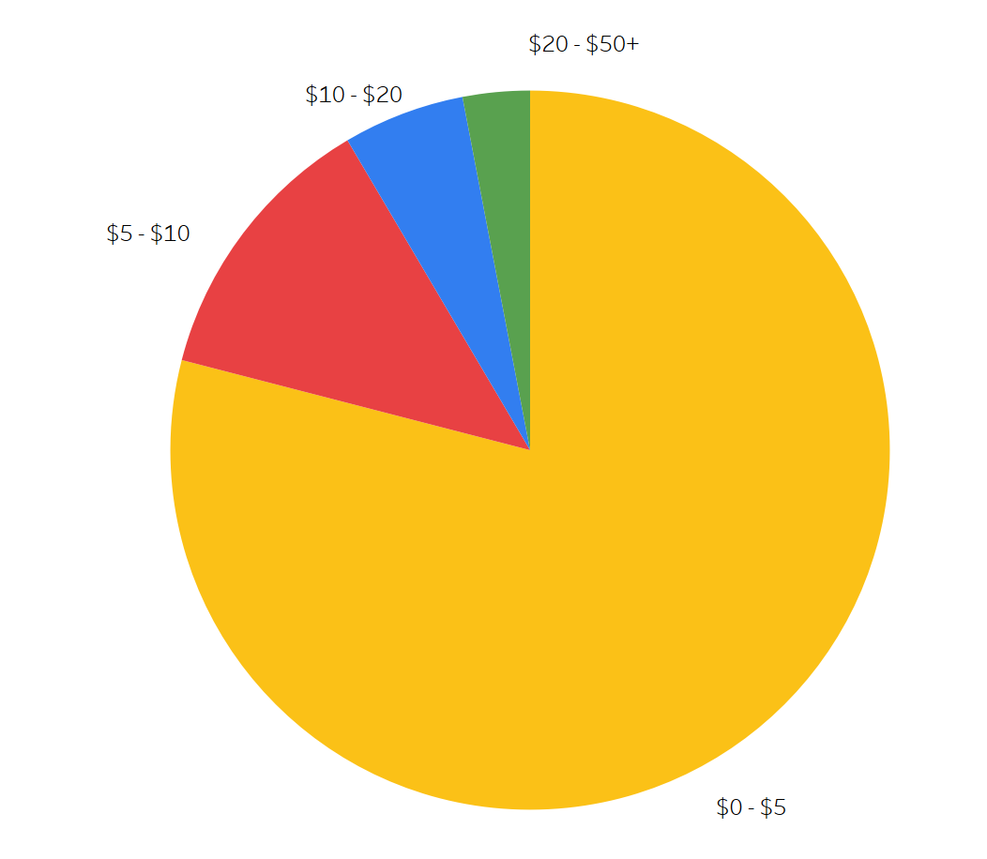
Landscape of Pricing
95%
Most categories have more percentage of free apps.
most paid apps are priced within the $0-$5 range
“Medical” has large paid apps

Slide 12
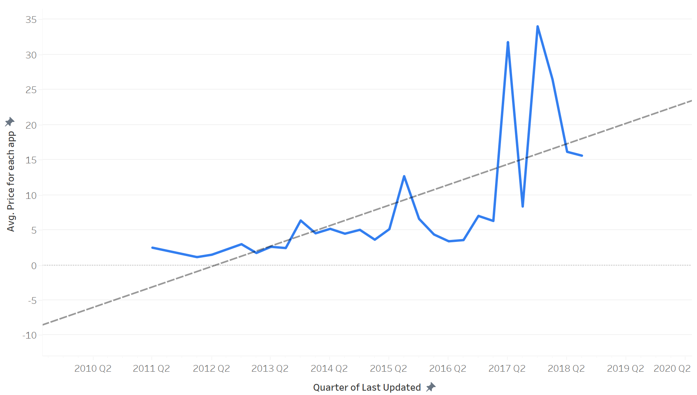
How App Prices Have Evolved?
95%
P-value=0.00013
As time goes by, the more updated the app is, the more expensive it is.

Slide 13
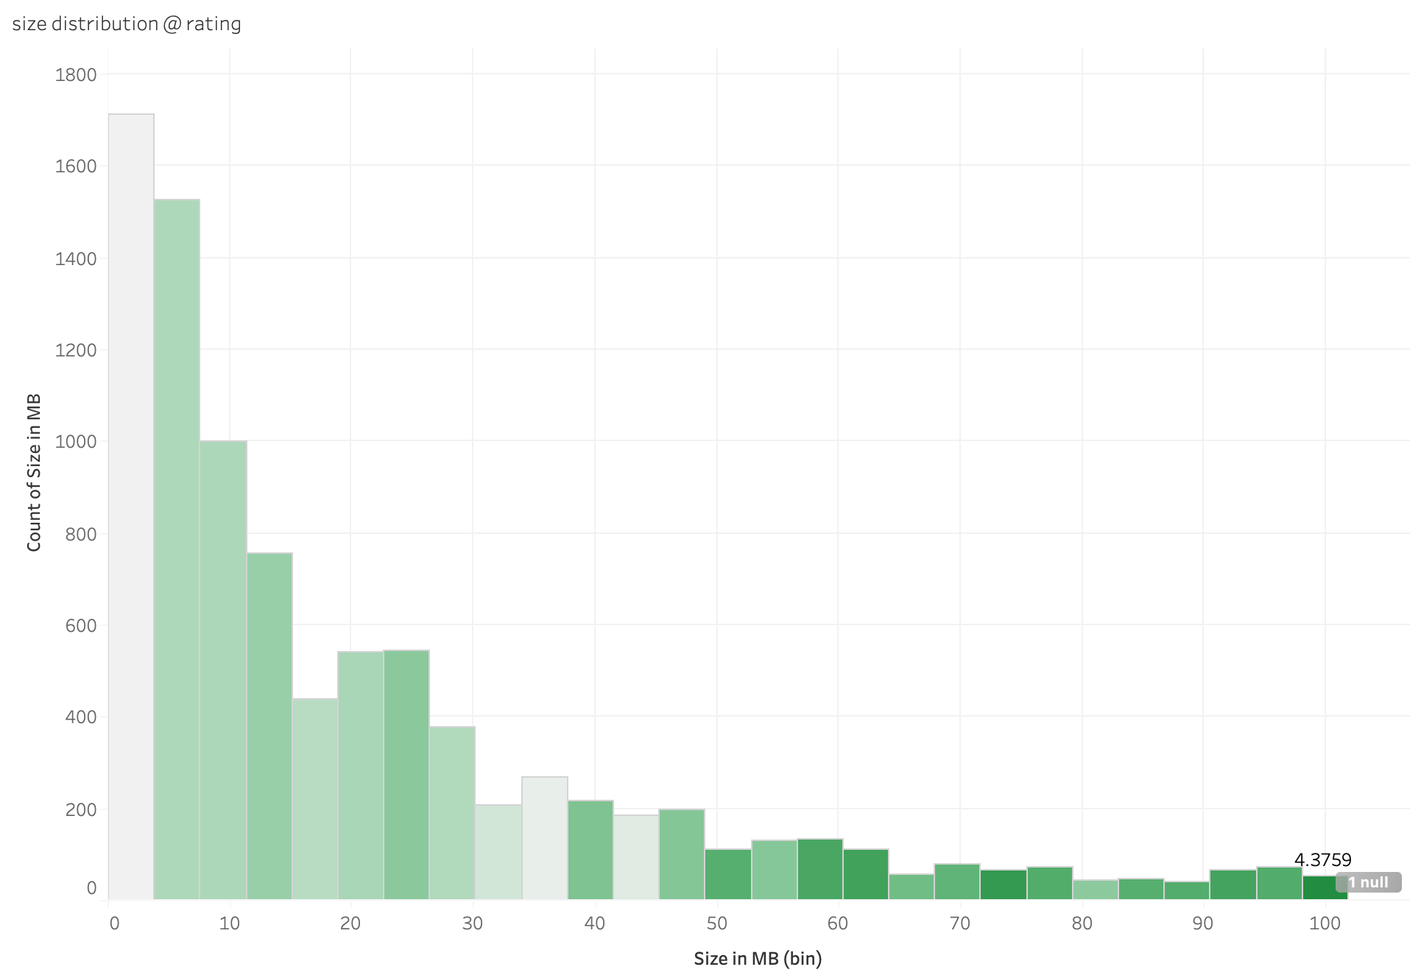
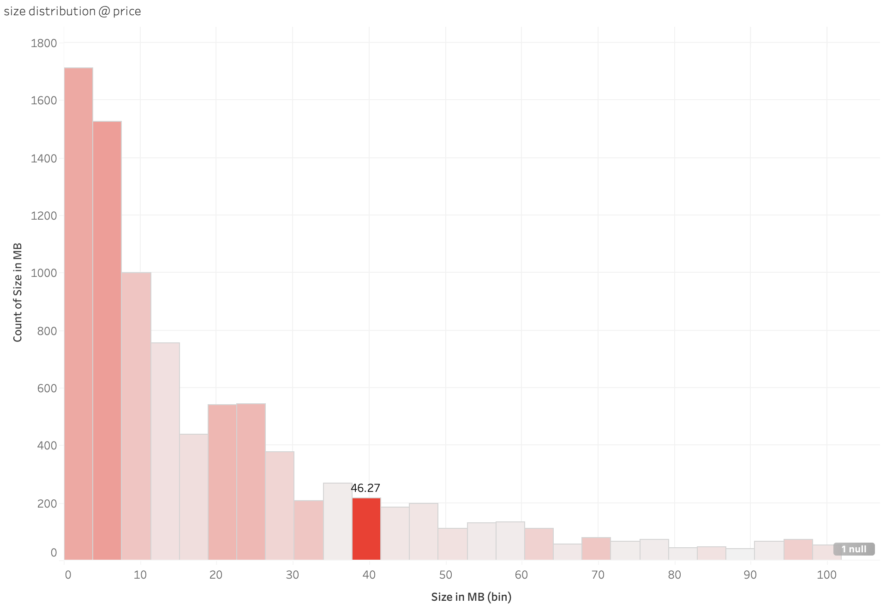
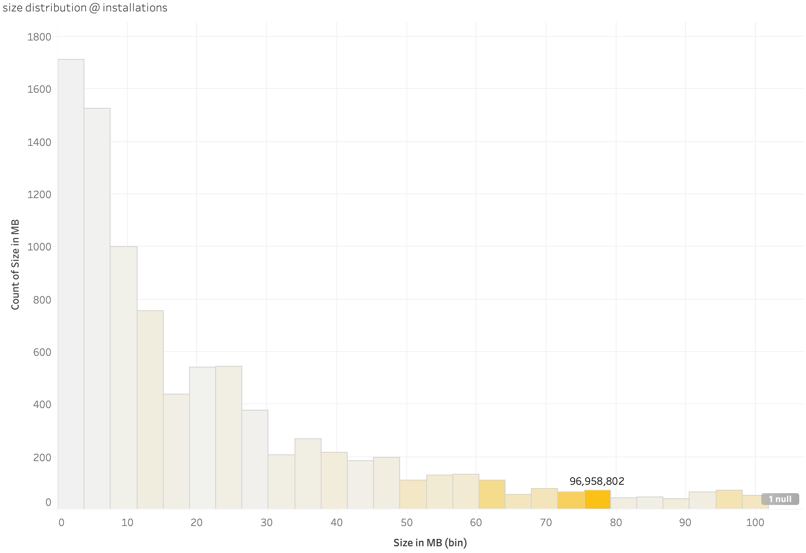
What’s the landscape of app sizes?
95%
More specifically, what is the size of apps with a maximum price, rating, and installations?
The range of size with highest rating:
[40,98]
The range of size with highest price:
[38,42]
The range of size with most installations:
[71,75]
Size distribution with rating/price/installations

Slide 14
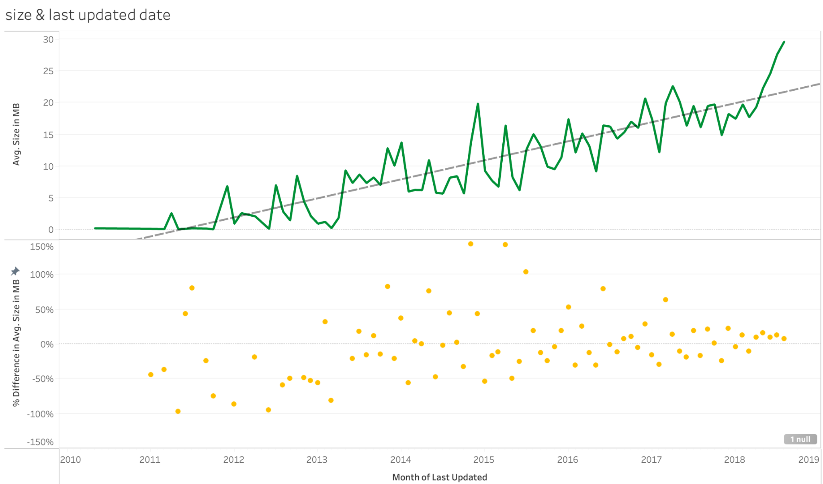
What’s the landscape of app sizes?
95%
How does the latest update impact app size?
Trend line
the change in app size over time
Many of these apps experienced significant size increases following their latest updates
Scatter line
the differences between each month’s updates
This trend has become more consistent, with size changes typically ranging between -50% to +50% from one month to the next.
From an overall app perspective, we recommend:
maintaining an optimal size range of 40 to 80 MB to achieve the optimal goal of price, ratings & installations.
Over time, this size can be adjusted by up to 50% based on the app's development needs and user feedback.

Slide 15
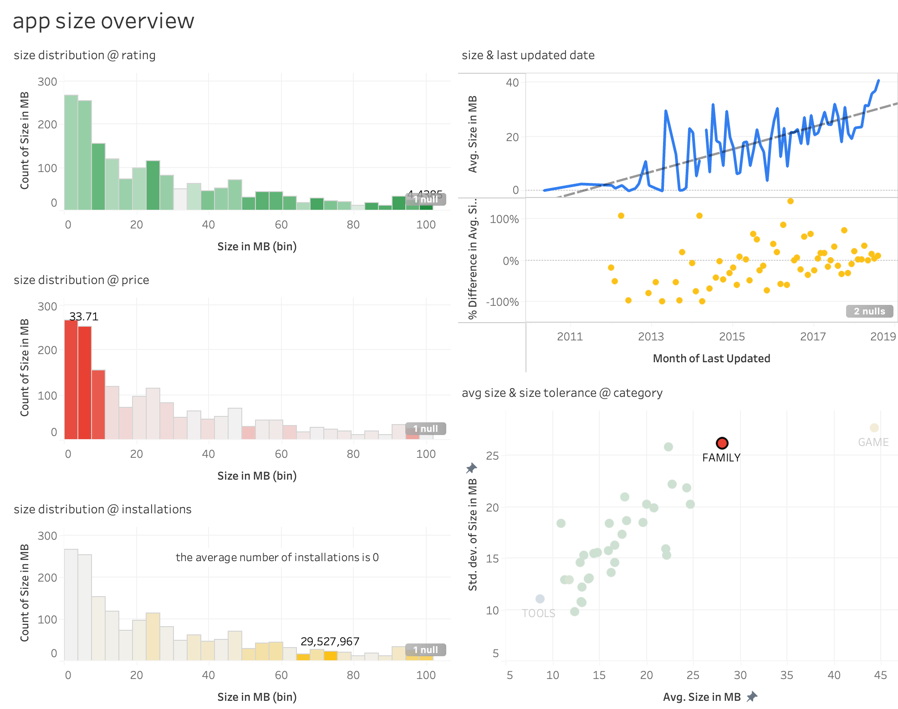
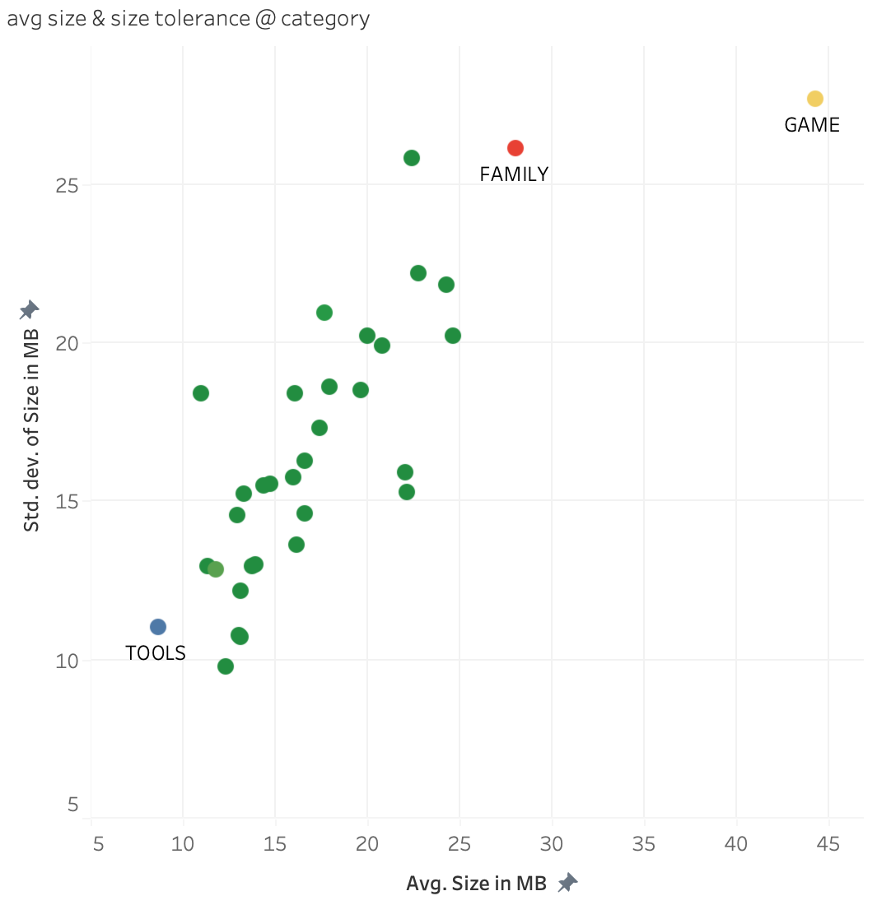
What’s the landscape of app sizes?
95%
which category exhibits the largest app size? which has the highest size tolerance?
X - axis: avg size @ category
Y - axis: std dev @ category
both game and family categories rank prominently in both indicators
pinpoint the ideal category for your app's objectives,
aligning your size choice with the category's expectations

Slide 16
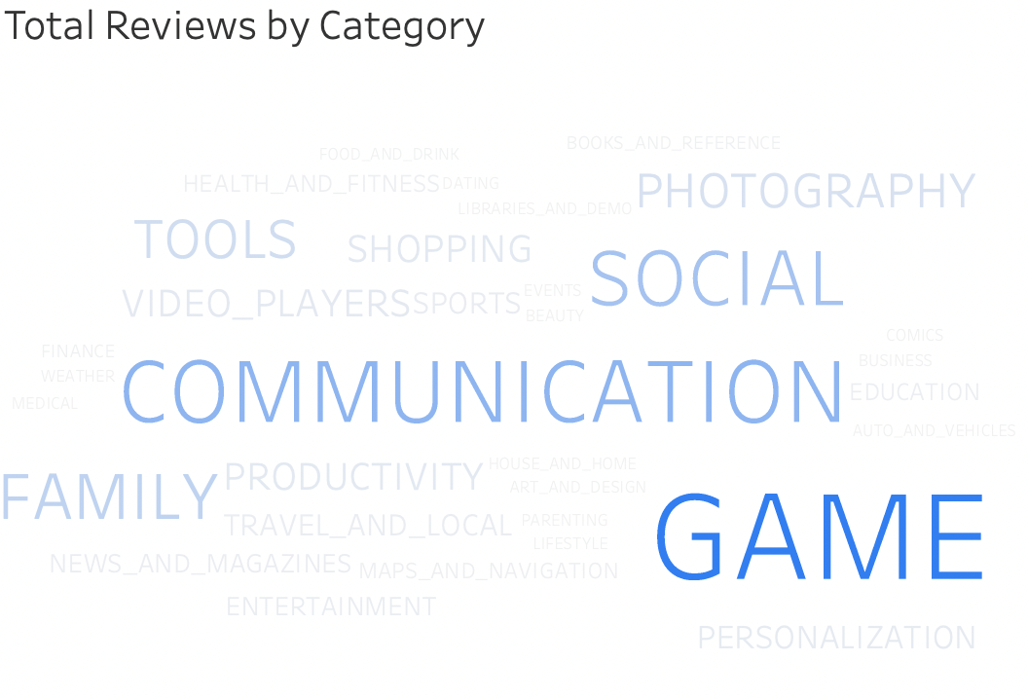
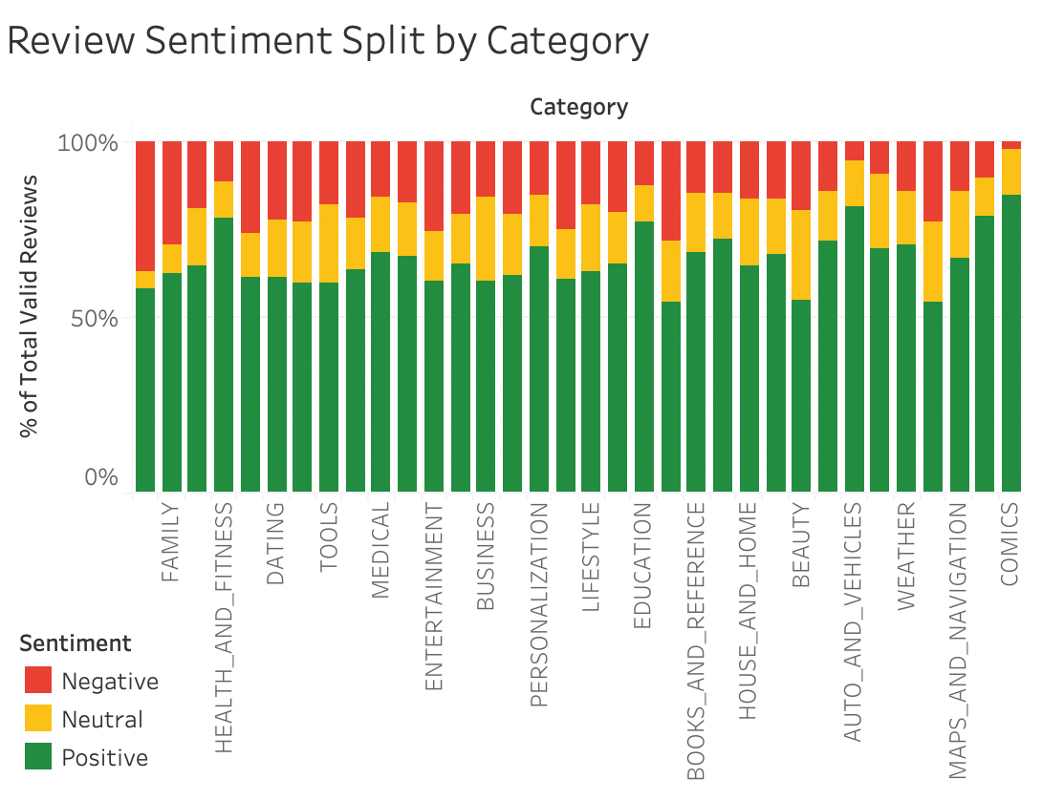
Landscape of Reviews - by Category
95%
What is the distribution of Review?
Most categories received more than 50 percent positive reviews
GAME Category has the most reviews

Slide 17
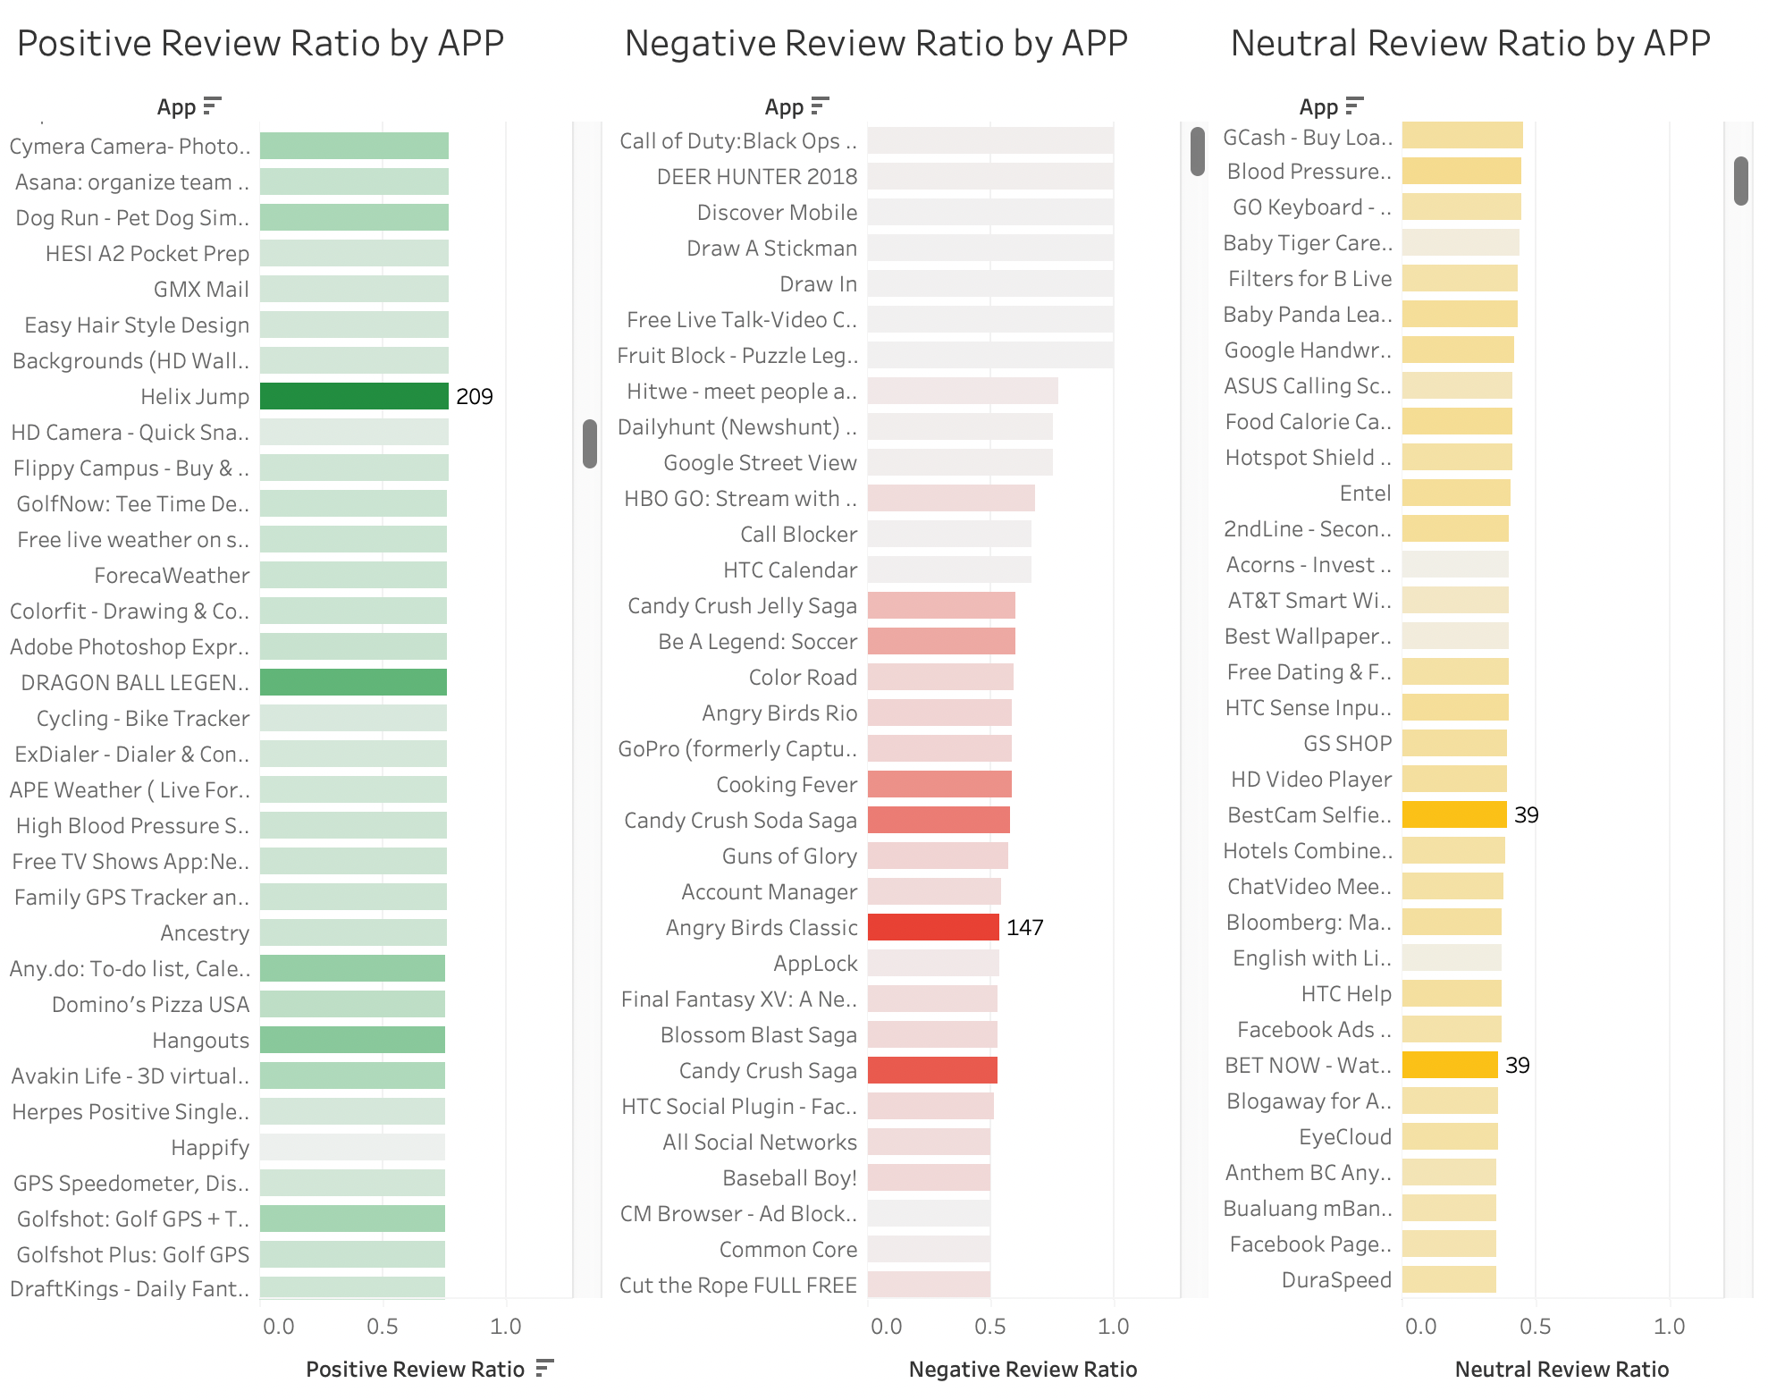
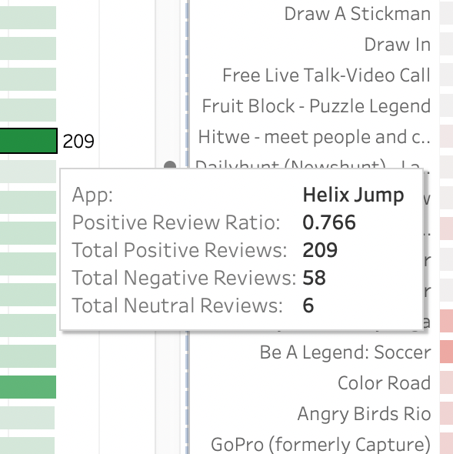
Reviews Sentiment - by APP
95%
These sheets show the ratio of positive, negative, and neutral reviews for each app, ranked from highest to lowest. The color distribution represents the number of reviews, and the darker the color, the more reviews the APP has.
How can these sheets work in the dashboard?

Slide 18
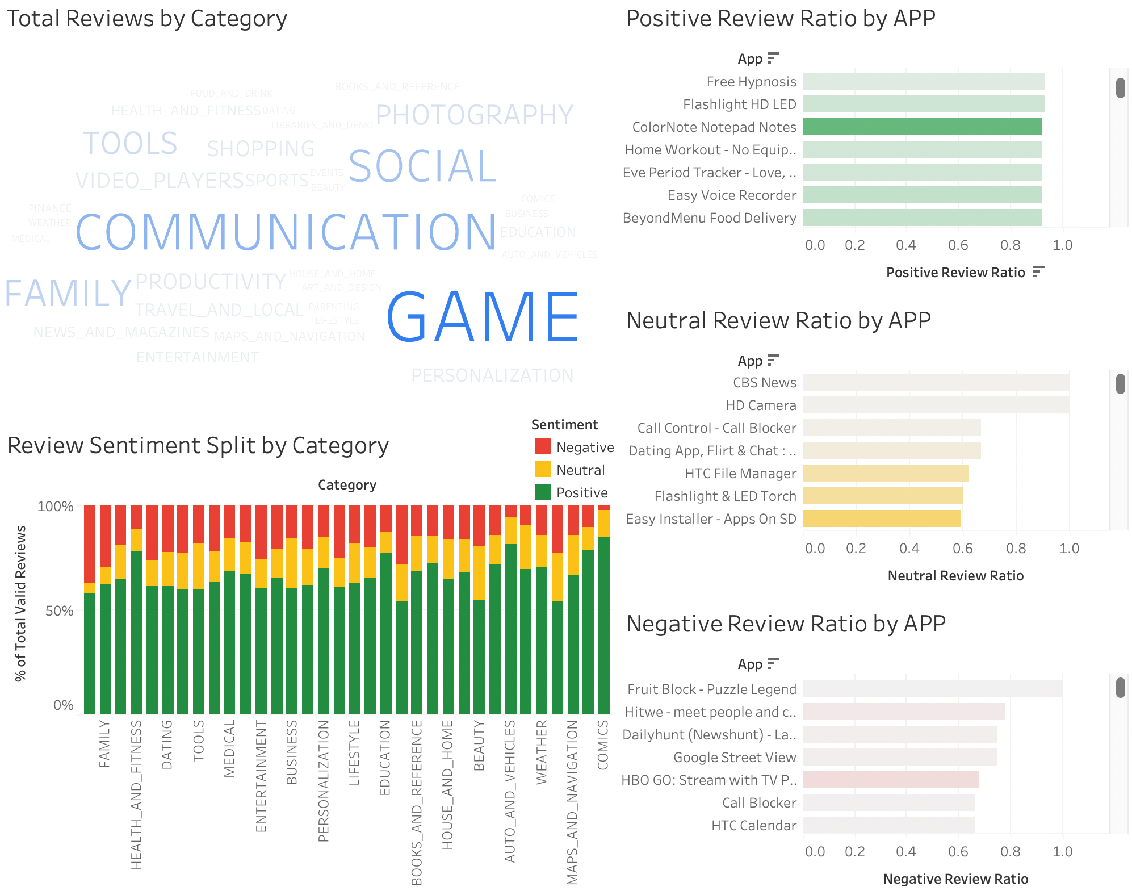
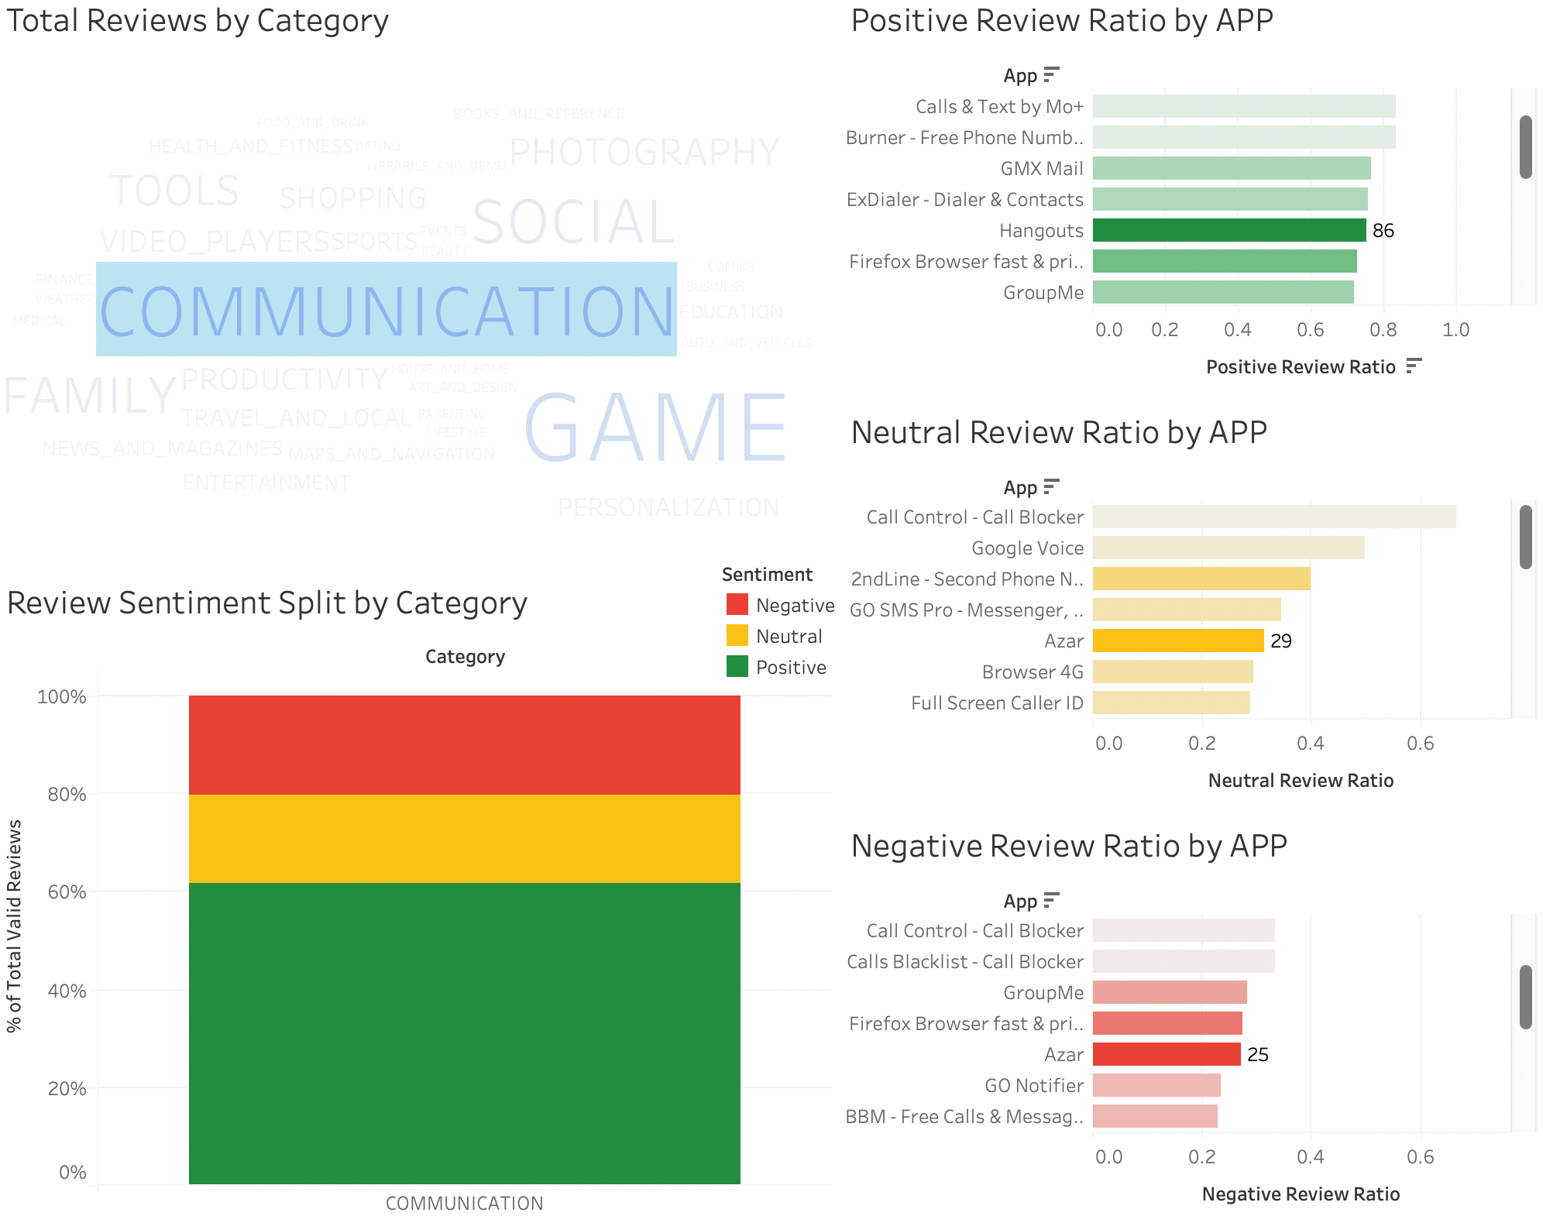
Landscape of Reviews
95%
Which app can we choose to download?
Choose apps with a high ratio of positive reviews and a large number of positive reviews.

Slide 19
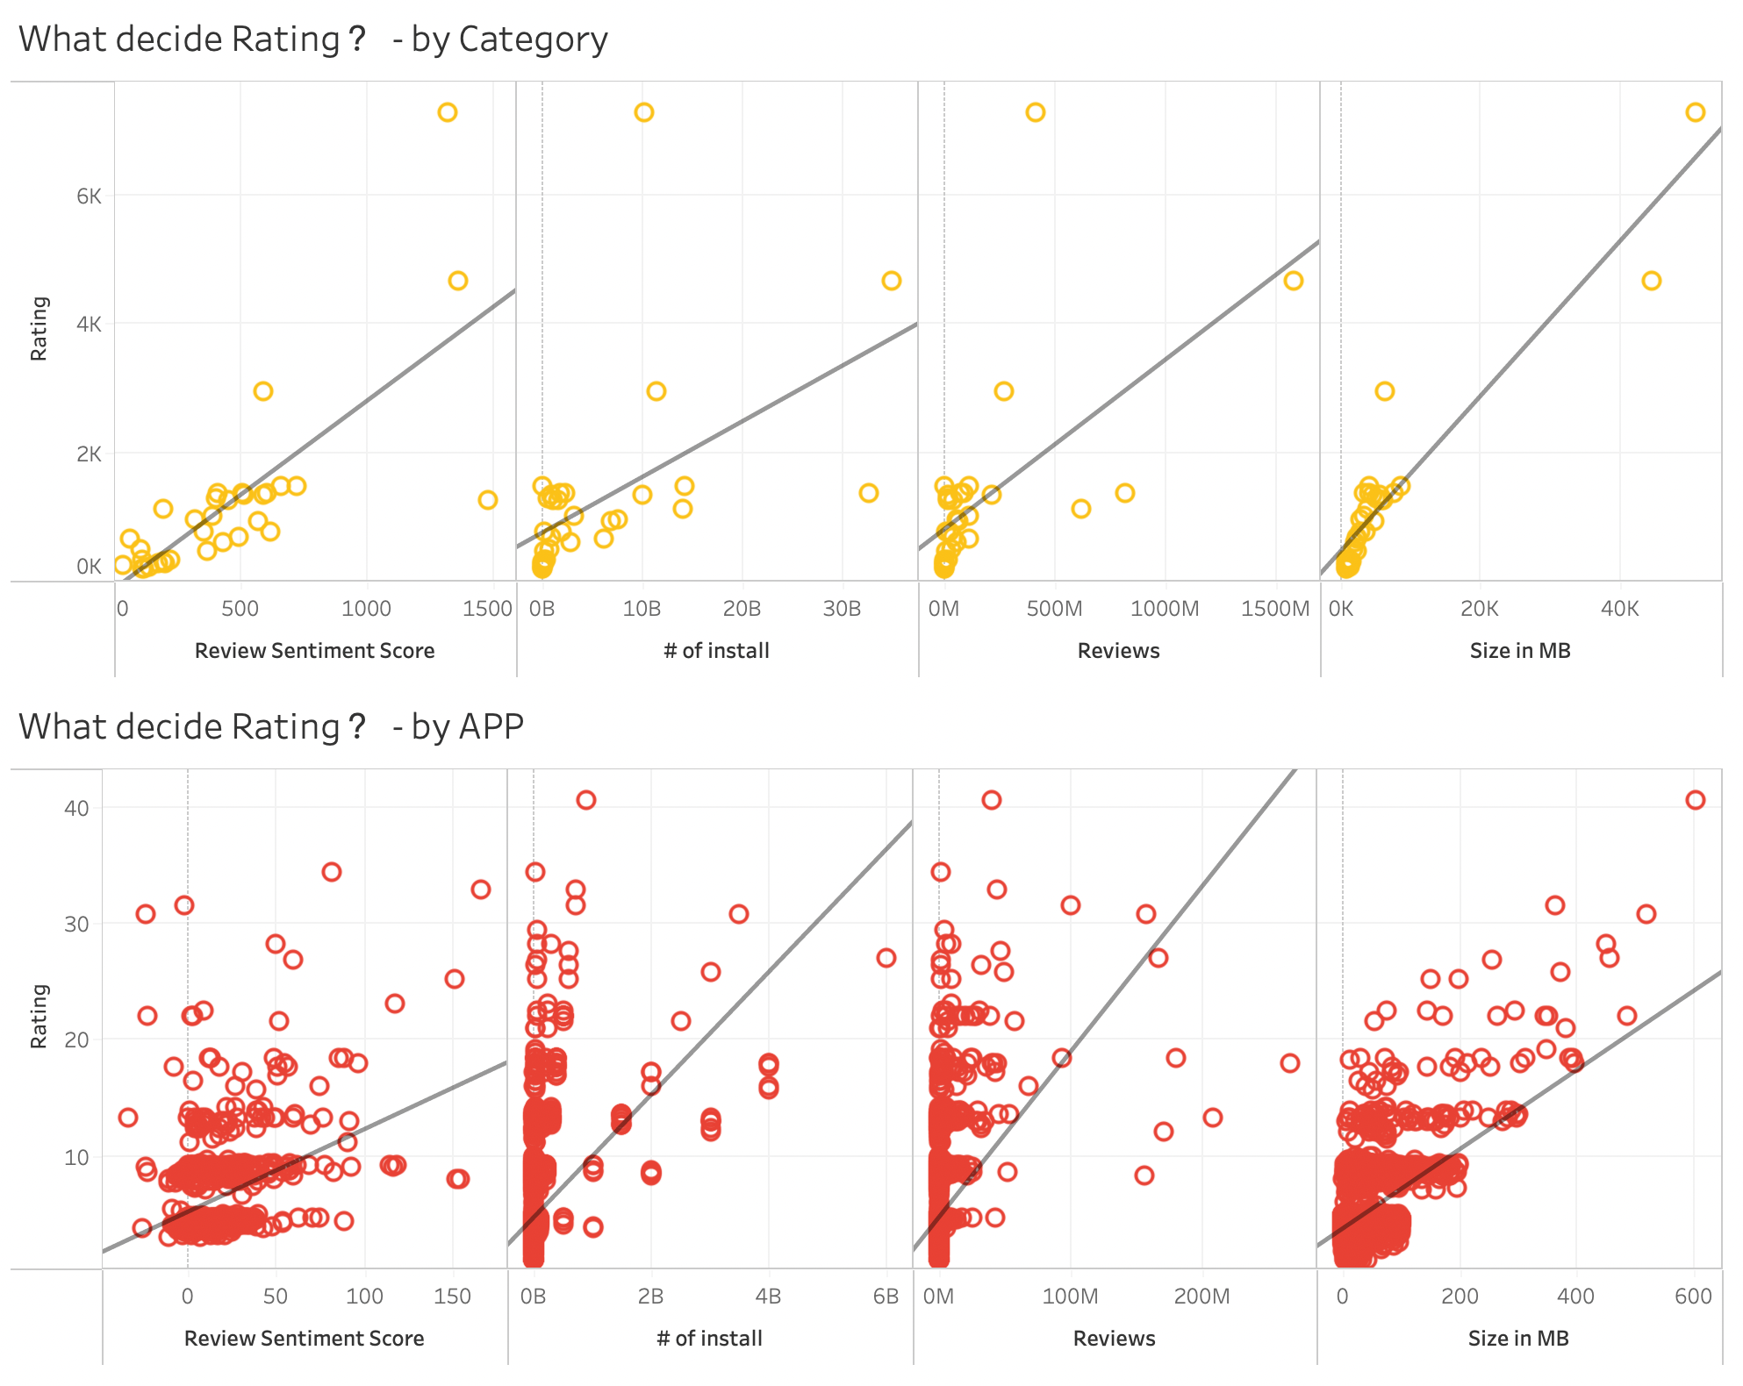
What Decides Rating？
95%
Review Sentiment Score, # of install, Reviews and Size in MB had a significant positive impact on Rating.

Slide 20
Summary of Findings
95%
To improve the overall performance and user satisfaction
App Developers and Marketing Analyst can focus on Review Sentiment Score, # of install, Reviews, Size in MB.
To make better pricing strategies
Upon pricing research, paid apps generally receive higher user ratings, indicating a perception of better quality. Developers can leverage this for monetization strategies. Most paid apps are priced within the $0-$5 range, revealing a competitive market where lower prices attract more users. Additionally, the trend of increasing app prices over time suggests market maturity and improved app quality.
To decide the optimal app size,
developers should analyze the Google Play Store landscape, consider update impacts, and account for category-specific expectations. Targeting a size range of 40 to 90 MB, while adjusting for trends and variations in high average & high tolerance categories like games and family, will significantly enhance app performance in price, ratings, and installations.
To decide which app to download under a particular category
You can prioritize apps with high rates of positive reviews and avoid apps with high rates of negative reviews. It can be used as a reference for applications with a high neutral review ratio. When choosing an app, you also need to consider its popularity, which is the total number of positive reviews. As a result, we prefer apps that have a high ratio of positive reviews and a high number of positive reviews.

Slide 21
Thank you for listening!
95%

Slide 22
Reference
95%
https://www.kaggle.com/datasets/lava18/google-play-store-apps?select=googleplaystore_user_reviews.csv
https://explodingtopics.com/blog/iphone-android-users

